Slide 1
Summary of Data
N mass Total = 377, N SIA Total = 322
Level | Mean Age (Age Range) | N (mass) | Mean Mass (g) | N (SIA) | Mean delta 13C | Mean 15N | SEA
1 | 729 (0-1458) | 18 | 87.84 | 13 | -17.35 | 5.63 | 10.52
2 | 2116.5 (1458-2775) | 22 | 88.05 | 26 | -17.7 | 5.31 | 5.2
3 | 3763 (3104-4422) | 7 | 91.26 | 7 | -18.16 | 6.20 | 9.15
4 | 5080.5 (4751-5410) | 14 | 82.58 | 13 | -17.02 | 6.48 | 5.9
5 | 5739.5 (5410-6069) | 20 | 88.37 | 28 | -16.63 | 5.74 | 6.31
6 | 6233.5 (6069-6398) | 21 | 86.75 | 29 | -16.6 | 5.87 | 5.76
7 | 6563 (6398-6728) | 29 | 92.06 | 15 | -17.03 | 6.09 | 5.63
8 | 7222 (6728-7716) | 21 | 83.7 | 25 | -17.6 | 6.12 | 7.52
9 | 7880.5 (7716-8045) | 19 | 85.5 | 12 | -14.57 | 7.19 | 9.17
10 | 8210 (8045-8375) | 16 | 89.74 | 14 | -15.91 | 7.27 | 9.84
11 | 8539.5 (8375-8704) | 0 |  | 23 | -16.05 | 7 | 7.77
12 | 8868.5 (8704-9033) | 16 | 89.41 | 11 | -16.15 | 6.95 | 10.81
13 | 9198 (9033-9363) | 22 | 81.43 | 15 | -16.49 | 6.75 | 6.26
14 | 9528 (9363-9692) | 22 | 87.66 | 13 | -17.45 | 6.85 | 8.58
15 | 9857 (9692-10021) | 22 | 88.34 | 8 | -14.51 | 6.91 | 6.34
16 | 10186 (10021-10351) | 45 | 87.62 | 11 | -15.09 | 6.95 | 6.98
17 | 11010 (10351-11668) | 27 | 87.56 | 21 | -17.78 | 6.76 | 10.17
18 | 12359 (11668-13050) | 7 | 84.03 | 7 | -13.96 | 7.24 | 6.26
19 | 14505 (13915-15095) | 14 | 87.83 | 15 | -16.35 | 6.63 | 6.7
ODD | 13382 (11668-15095) | 15 | 76.9 | 16 | -16.67 | 7.08

Slide 2
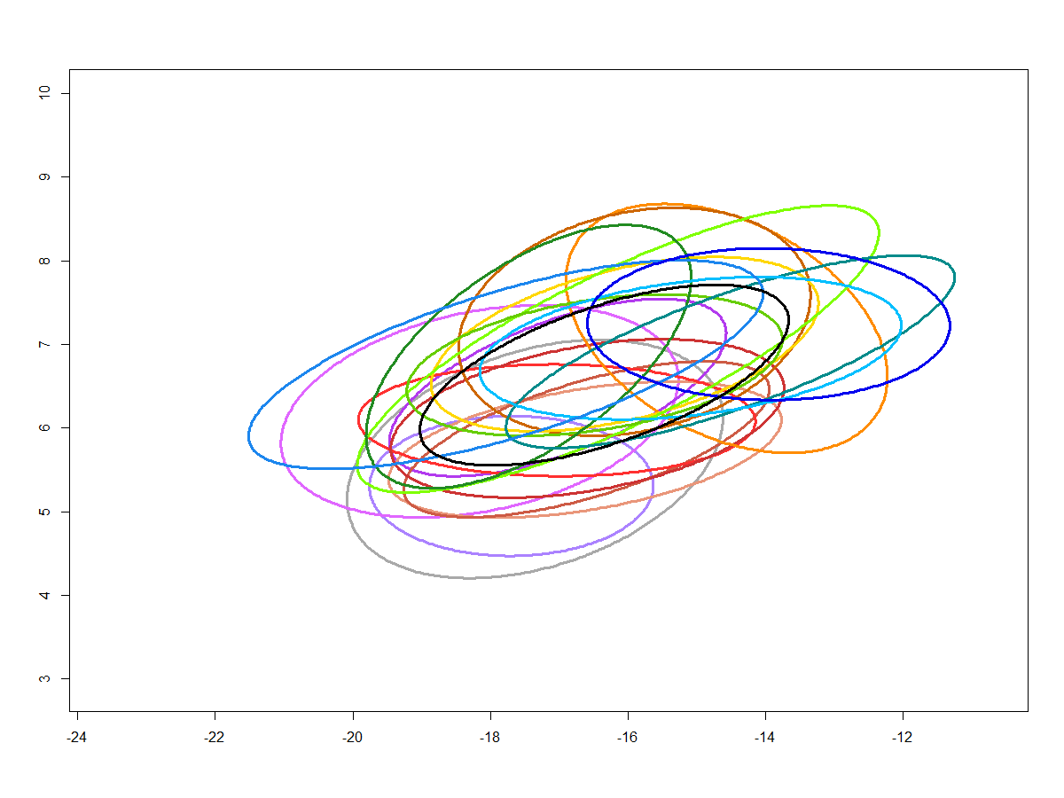
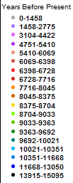
δ¹⁵N (‰)
3 4 5 6 7 8 9 10
-24 -22 -20 -18 -16 -14 -12
δ¹³C (‰)

Slide 3
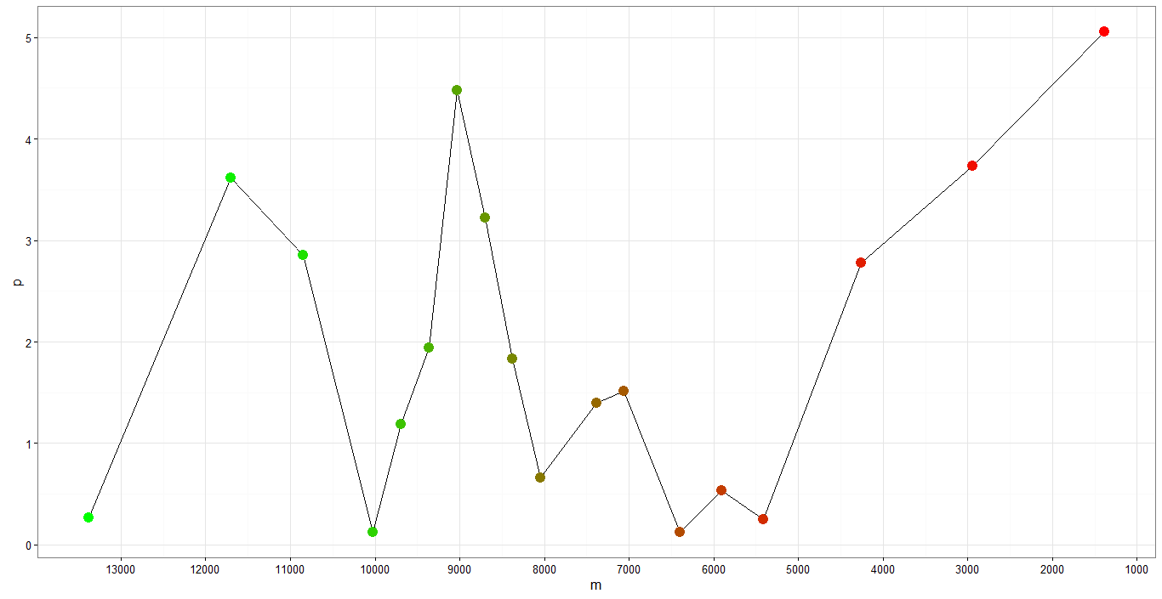
The breadth of the dietary niche of Sigmodon changes across time
Area (‰²)
0 1 2 3 4 5
13 12 11 10 9 8 7 6 5 4 3 2 1
Time (kyp)

Slide 4
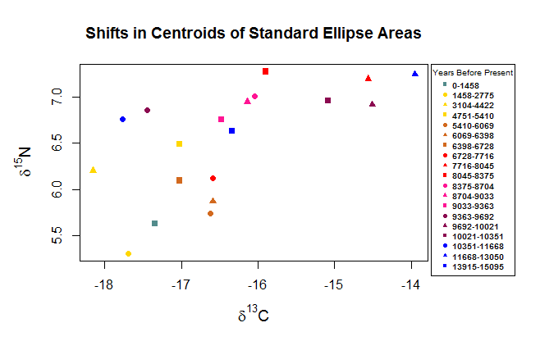

Slide 5
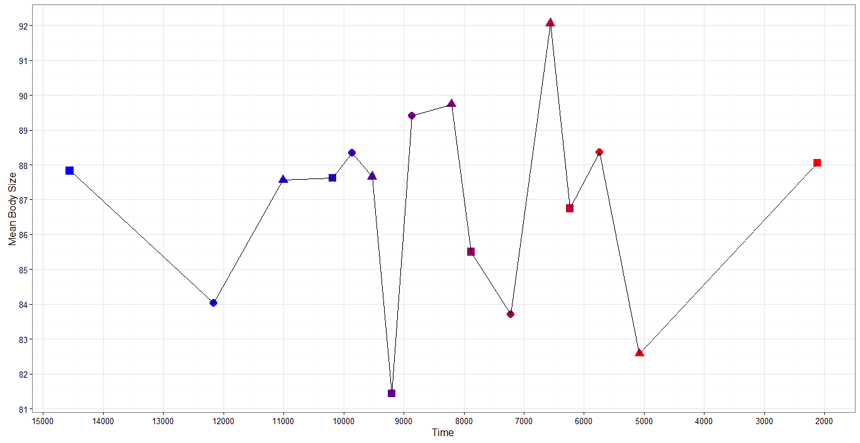
Body size variation across time compare to temperature
Body Mass (g)
81 82 83 84 85 86 87 88 89 90 91 92
15 14 13 12 11 10 9 8 7 6 5 4 3 2
Time (kyp)

